Slide 1
Riaan Kruger 92014596 Project: Java and Web Development DLBCSPJWD01
Phase_2
Presentation
https://github.com/hpearcem/MarketPlace.git

Slide 2
Purpose of the webpage
# MarketPlace
An online marketplace for interesting things. The page is designed for a sole proprietor online shop,
where this person seeks out specials and weird and wonderful products, and re-sells them on the at a profit.
This is a very basic implementation of that business, payment is done via an invoice and loading of products will be done
by the business an administrator.
Expansion of this page is however possible, electronic payment methods can be added. And the business idea can be
expanded on.

Slide 3
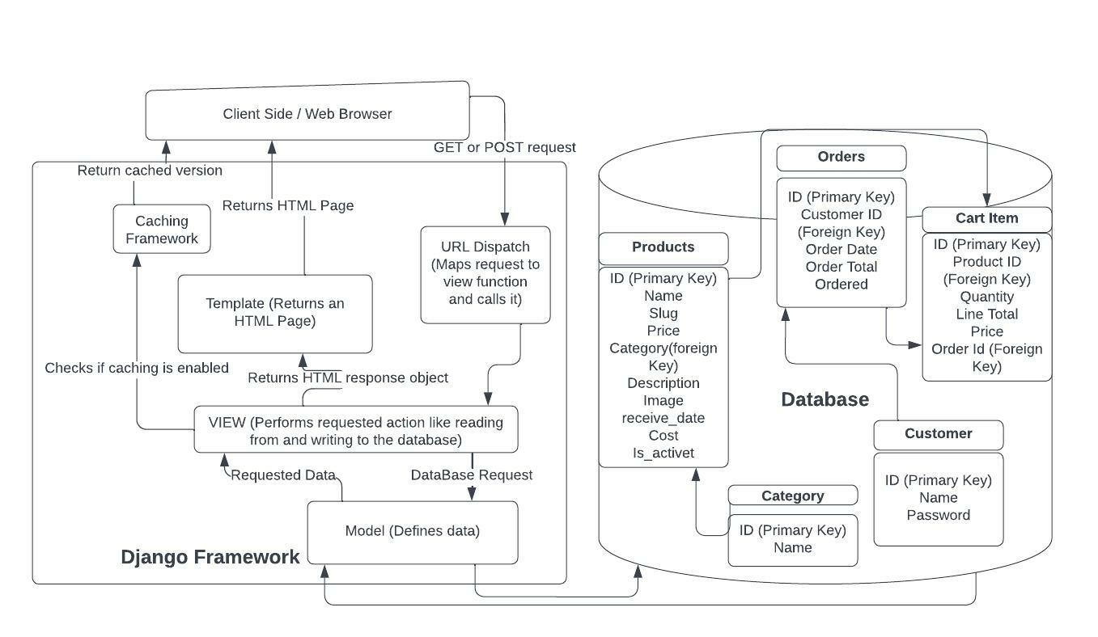
Architecture Diagram

Slide 4
Technologies Used
Database:
Sqlite3
Framework:
Django
Front End:
HTML
Bootstrap
CSS
JavaScript

Slide 5
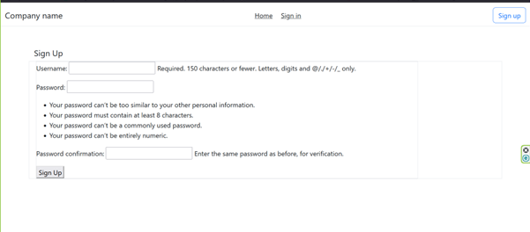
Sign-up page

Slide 6
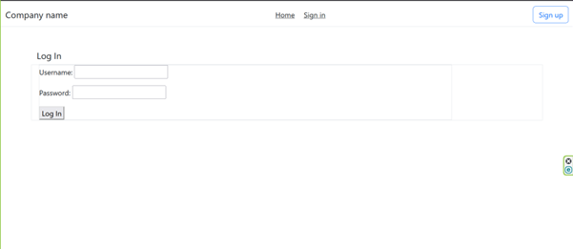
Sign-in page

Slide 7
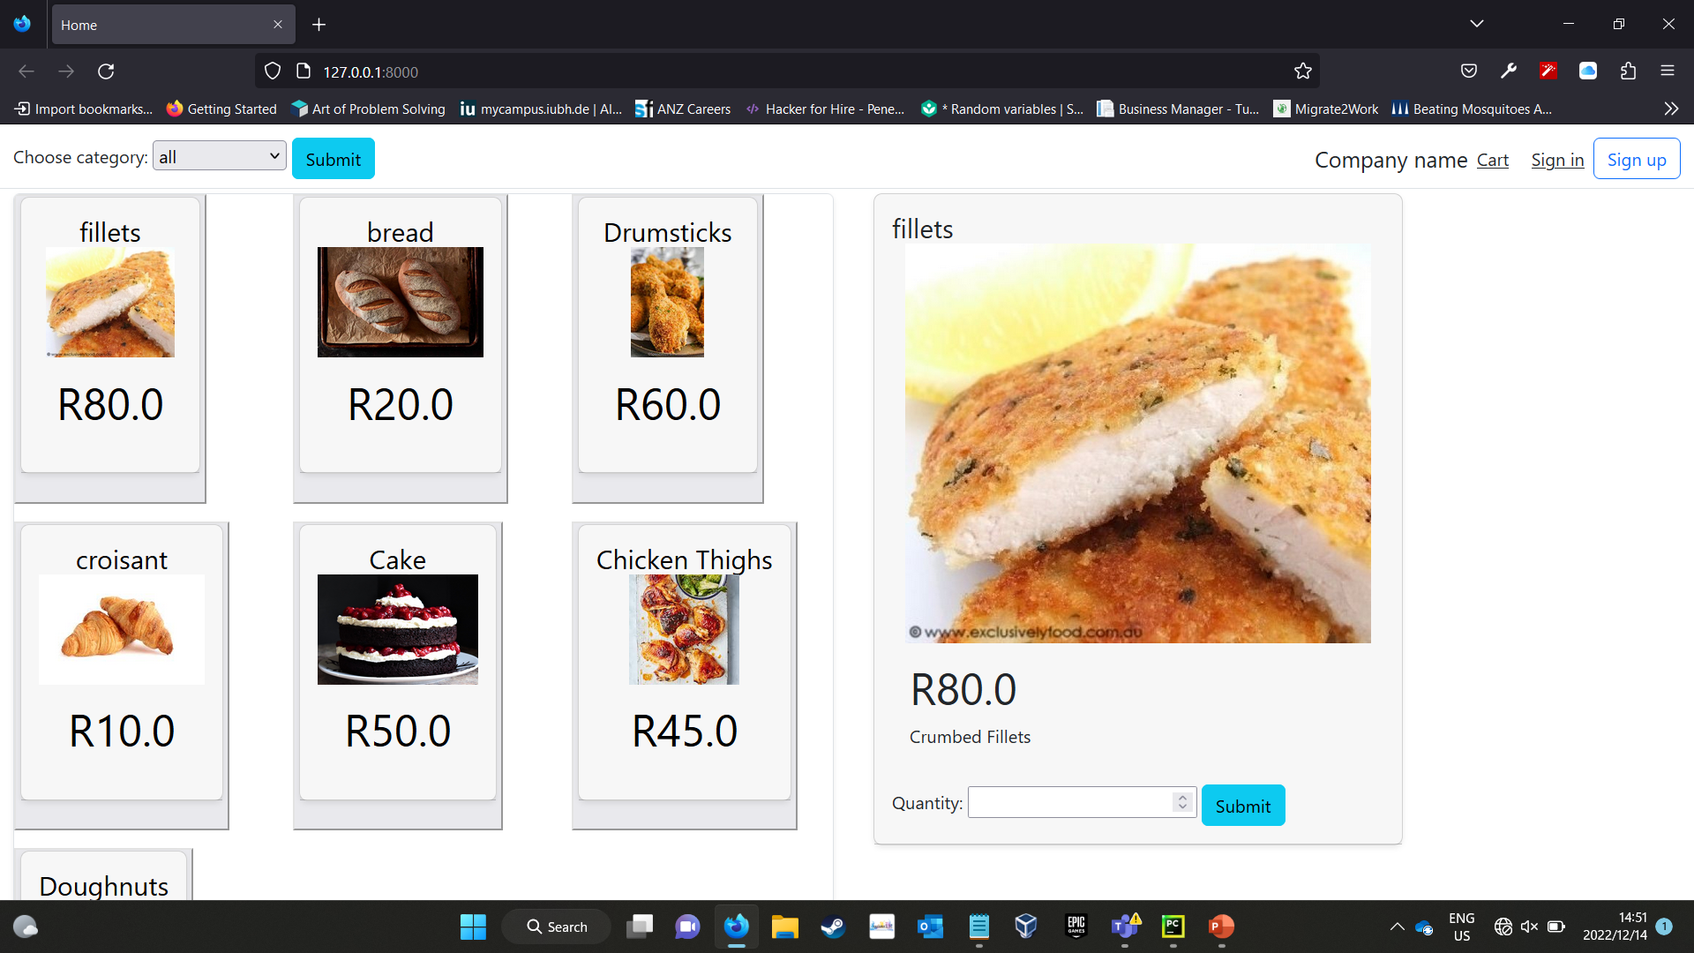
Screenshot of the home page

Slide 8
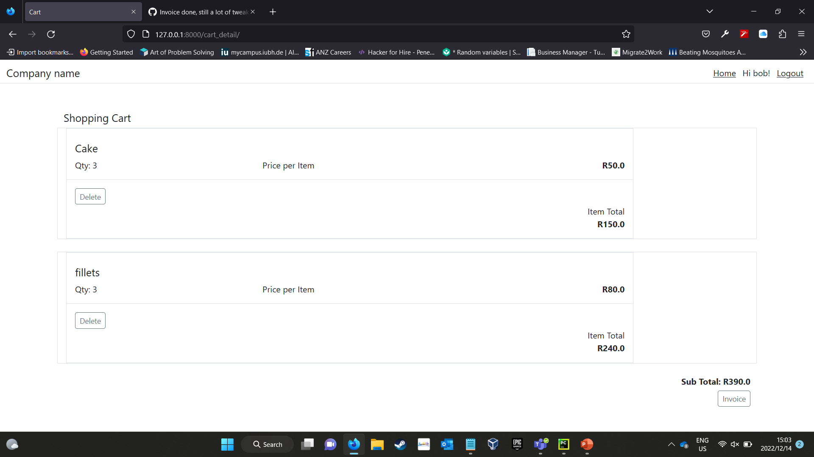
Screenshot of the shopping cart

Slide 9
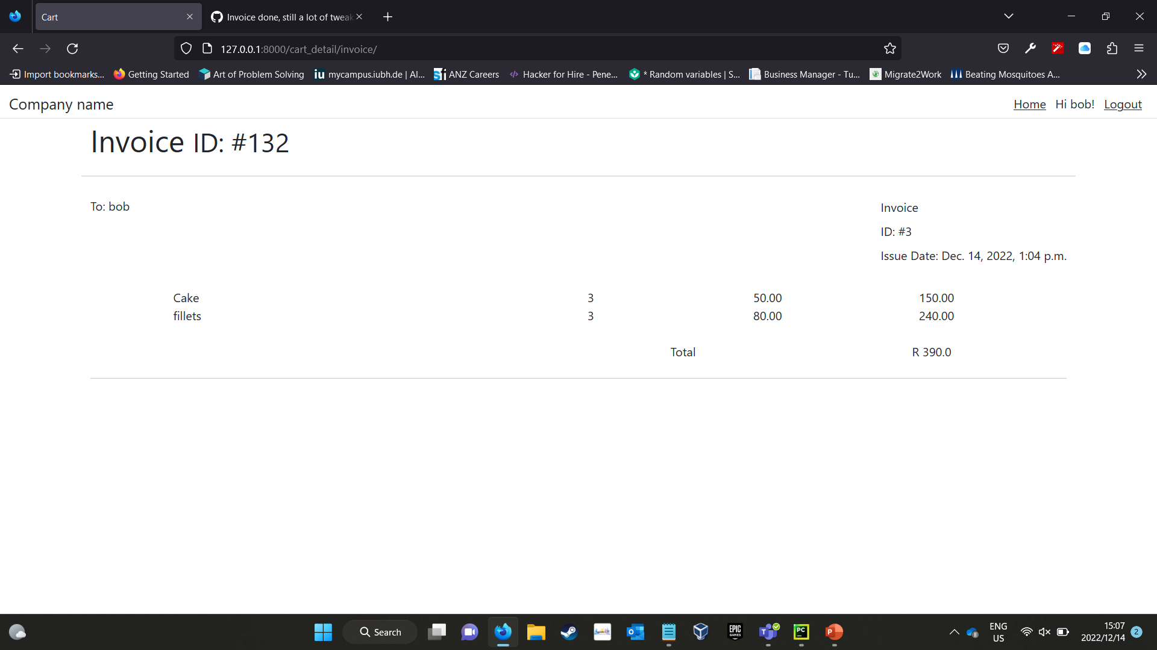
Screenshot of the invoice page

Slide 10
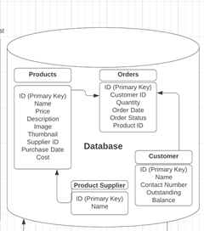
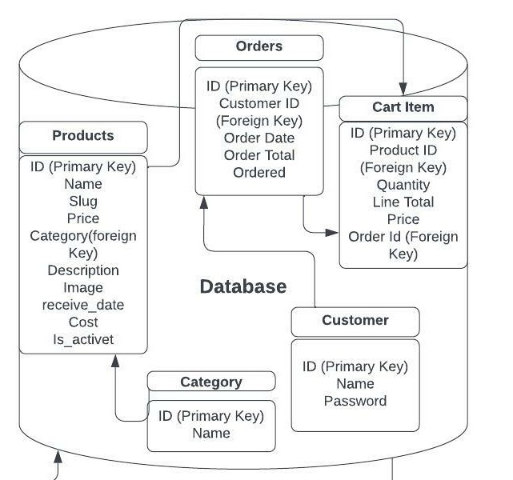
•Searching by category and not supplier makes more sense and allows the client to find product they are looking for much easier by limiting the number of products to choose from to a specific category of products. •Allowing the deactivation of product makes it possible to remove a product from the site without removing it from the database, in case of temporary unavailability or other supply issues. •Cart items makes creating a complete order easier as the items are stored separately As the orders are being paid before delivery, accounts were not necessary.
Changes from the proposal

Slide 11
